Slide 1
CRITICAL ANALYSIS
Presentation by:
Fatima Azfar, Mohammad Anas and Khizar Farooq

Slide 2

What is Critical Analysis and why do we use it?
The purpose for writing a critique is to evaluate somebody's work in order to increase the reader's understanding of it. A critical analysis is subjective writing because it expresses the writer's opinion or evaluation of a text. Analysis means to break down and study the parts. Writing a critical paper requires two steps: critical reading and critical writing.

Slide 3
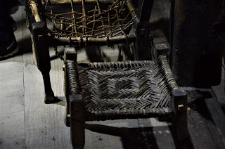
For Granted Chairs
By Husnain Raza

Slide 4
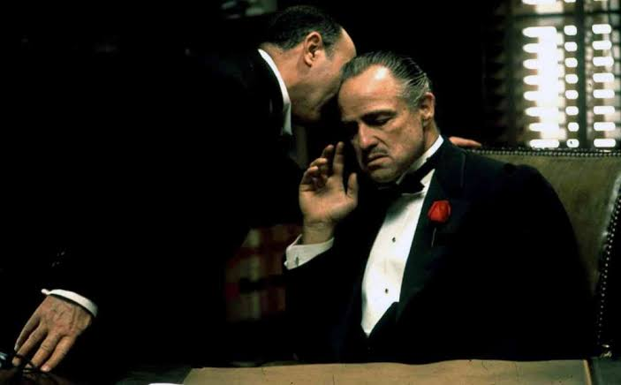
Introduction
The article is titled “FOR GRANTED CHAIRS”
Written by Husnain Raza
Published on the website “Mythical Illusions”

Slide 5

Main idea and logical summary
The main idea of this article is that Pakistan has been left behind in the global race of technology and science because of the chair holders that suffer from ‘Balance disorder’ as what the writer calls it. The writer mentions that this balance disorder isn’t caused by the pillars of the chairs but by the self-doubt and self-efficacy that they hold within themselves. Everyone has set their minds to the thought that this nation is restricted to a particular person and that he is not answerable for the disruption.

Slide 6

Tone, Style and purpose of the author
The chair holders are targeted and criticized on their irresponsible attitude and blaming others even though they have the power to make a change and help the country move forward.
The author is clearly persuading the readers to not rely on others to move forwards and neither to take power for granted.
The author mentions the cause for Pakistan not advancing forwards like other countries and explains the devastating effects of it and his writing style is formal as he has used professional words like “Balance disorder” for criticism.

Slide 7

Effectiveness, topic’s treatment and appeal
The writer states “They don't know the chair they are sitting on carry knowledge, hard work, abilities and wisdom beneath them while practice and self-belief are giving them support on the sides.” which triggers the emotions of the reader, thus making the appeal of the author ‘Pathos’.
The author in the essay mentions imagining ‘if the chairs were handled with full potential’ which again is another emotion stimulating aspect in the essay.
The essay is effective as it states a really big issue to which every Pakistani can relate.

Slide 8

Conclusion
In this article, the readers are made realized about how far away do they stand from progression in many global fields and the blame is on the non serious chair holders. This article is very relevant to the current country condition and it is entirely a topic that should be addressed more to raise awareness about the rights of people as a nation and the fact that the issues are within the country and not from the outside.

Slide 9

Thank you for listening and hope you enjoyed as well as understood the topic completely. Adios :}

